Slide 1

W13 Fast Focus - Azure Pipelines Tips and Tricks
Mickey Gousset
DevOps Architect
Microsoft
Level: Intermediate to Advanced

Slide 2

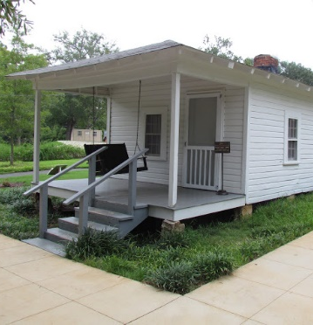

What is Tupelo, MS world-famous for?
Notes:
But first, and most importantly, I am from Tupelo, MS. Does anyone know what Tupelo, MS is world-famous for?
We are a small 35K town in north-east MS, and we get about 10K+ people a year that come to my small town, many from Europe.
**CLICK**
We are the birth-place of Elvis Presley.

Slide 3
Azure Pipelines Tips & Tricks
What Is Azure Pipelines
Pipeline Types – Build/Release, Classic/YAML
Variable Groups / Task Groups
Build Logs and System.Debug
Disable Tasks to Help With Debugging
Link Pipelines and Work Items
Token/Variable Replacement
Pipelines and Branch Policies
Environments
Gates and Approvals

Slide 4

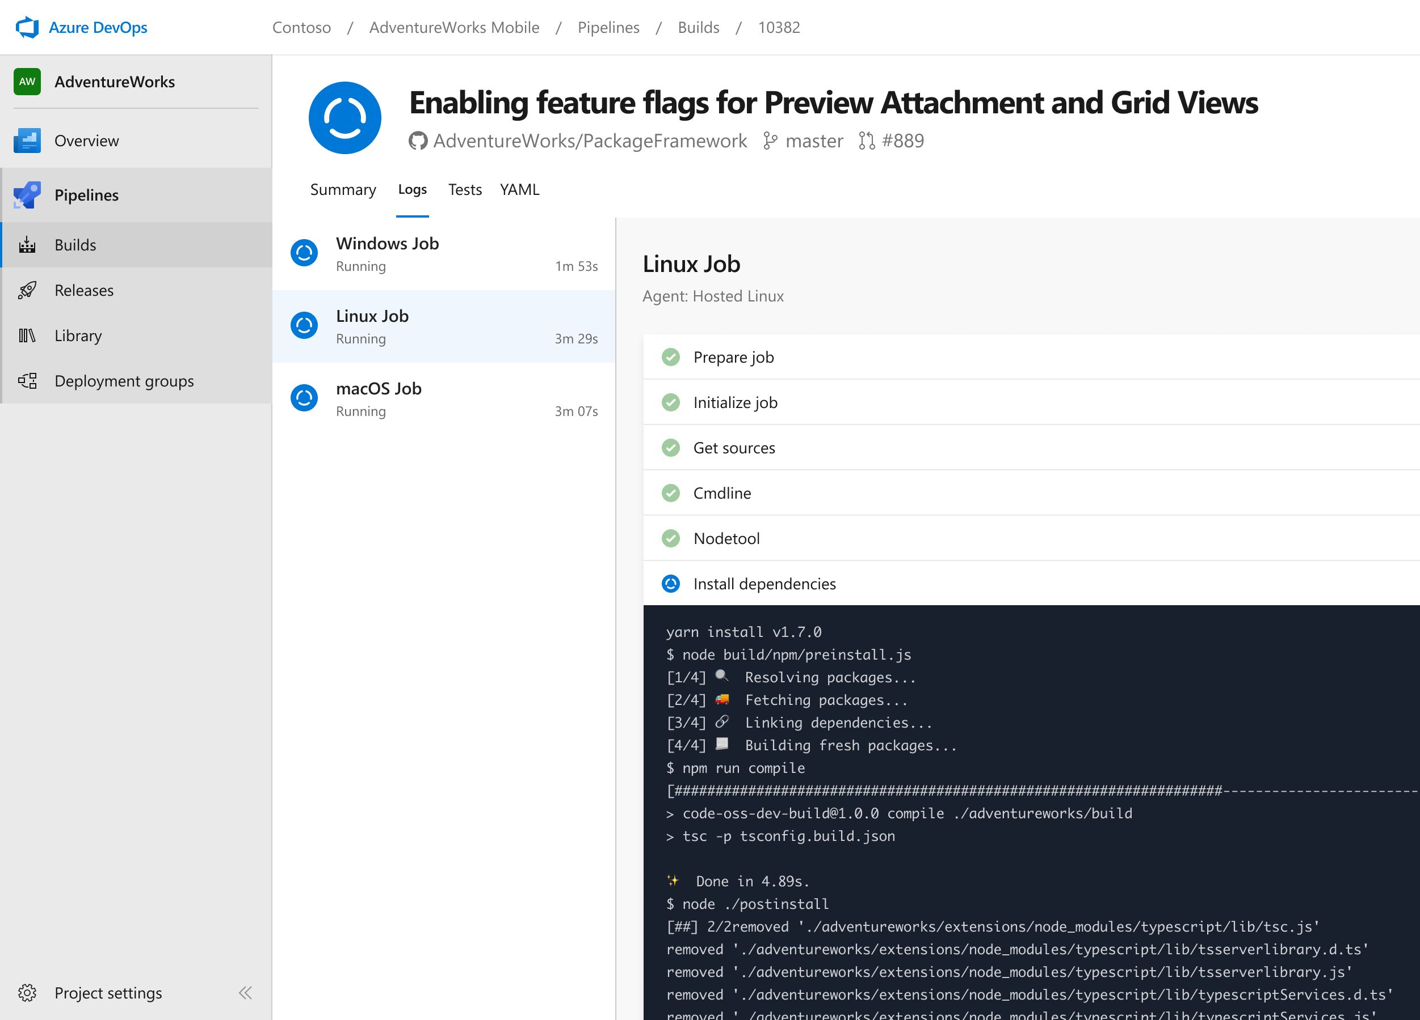




Azure Pipelines
Cloud-hosted pipelines for Linux, Windows and macOS, with unlimited minutes for open source
Any language, any platform, any cloud
Build, test, and deploy Node.js, Python, Java, PHP, Ruby, C/C++, .NET, Android, and iOS apps. Run in parallel on Linux, macOS, and Windows. Deploy to Azure, AWS, GCP or on-premises
Extensible
Explore and implement a wide range of community-built build, test, and deployment tasks, along with hundreds of extensions from Slack to SonarCloud. Support for YAML, reporting and more
Containers and Kubernetes
Easily build and push images to container registries like Docker Hub and Azure Container Registry. Deploy containers to individual hosts or Kubernetes.
Best-in-class for open source
Ensure fast continuous integration/continuous delivery (CI/CD) pipelines for every open source project. Get unlimited build minutes for all open source projects with up to 10 free parallel jobs across Linux, macOS and Windows
➔
https://azure.com/pipelines

Slide 5
Helpful Links
https://github.com/mickeygousset/conferencetalks
Slide Decks, Demo Notes, Code
https://youtube.com/mickeygousset
Lots of videos on DevOps, Azure DevOps, GitHub
https://docs.microsoft.com/en-us/azure/devops/pipelines/?view=azure-devops
Azure Pipelines Official Documentation

Slide 6











DevOps CAT team mission
Work with Microsoft’s largest customers to help them accelerate their DevOps transformation.

Slide 7

Me
Mickey Gousset
Joined Microsoft June-18
Dev Tools MVP - 14 years
Tupelo, Mississippi, USA
@mickey_gousset
mickeygousset.com
mickey.gousset@microsoft.com
https://youtube.com/mickeygousset

